Slide 1

DSC 530 Term Project
Astrid Fuentes
March 6th, 2021

Slide 2
Dataset and Variables
The dataset is a daily count of covid19 cases. I decided to keep the following variables:
Date: Date of report
Confirmed: Number of confirmed Covid19 cases
Deaths: Number of deaths by covid19
Recovered: Number of recovered patients
Active: Number of active cases
New Cases: Number of new cases reported
New Deaths: Number of new deaths reported
New Recoveries: Number of new recovered patients reported
Number of countries: Number of countries reporting.

Slide 3
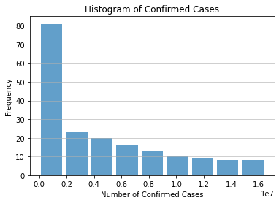
Histograms

Slide 4
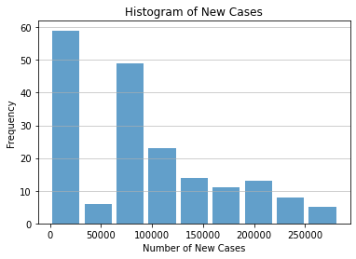
Histograms

Slide 5
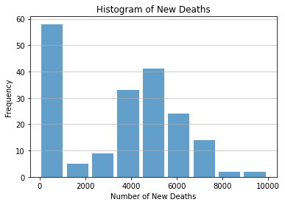
Histograms

Slide 6
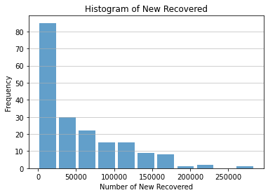
Histograms

Slide 7
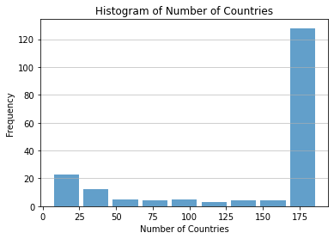
Histograms

Slide 8
Outliers
I do not see outliers in our histograms. It does make sense that after some time, the numbers become larger since some of the variables are accumulating number of patients over time.
If I had to deal with outliers, I would see if it makes sense to drop them from the data set or replace them with the mean values for that column.

Slide 9
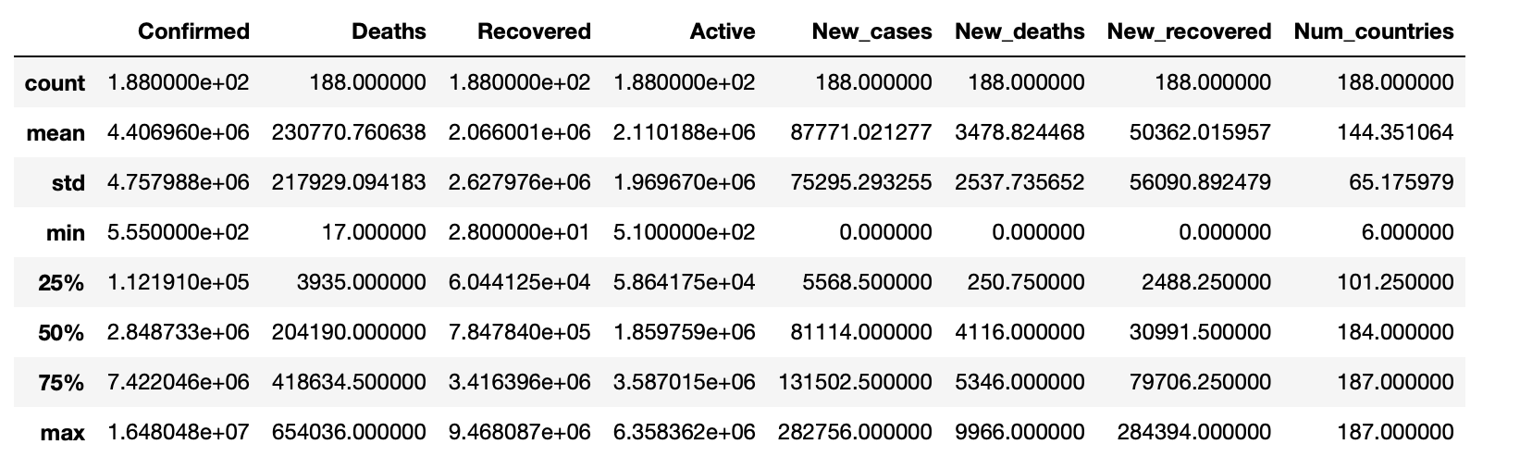
Descriptive Statistics: Mean, Standard Deviation, Minimum, Maximum, Quartiles

Slide 10
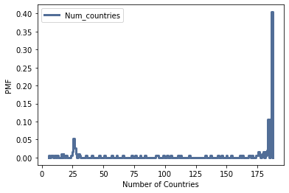
Probability Mass Function Number of Countries Affected by Covid-19

Slide 11
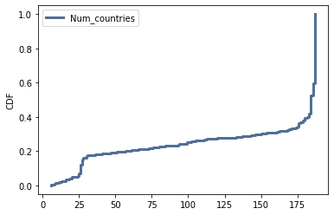
Cumulative Distribution Function Number of Countries Affected by Covid-19

Slide 12
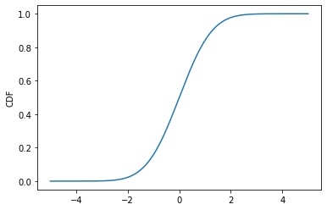
Comparing with CDF of the Normal Distribution

Slide 13
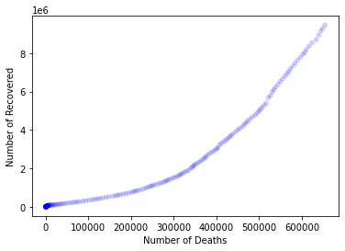
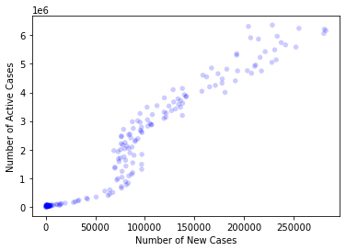
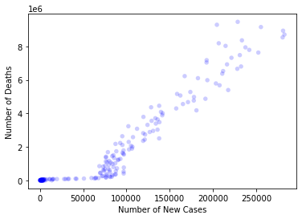
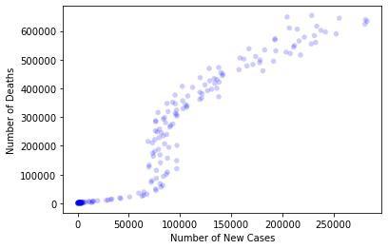
Scatter Plots

Slide 14
Hypothesis Test
We created two groups or subsets of data for first and second semesters using a cut off Date of July 1st. 2020
df_first_sem = df[df['date'] <'2020-07-01']
df_sec_sem = df[df['Date'] >='2020-07-01']
Our hypothesis is that the two groups are different meaning that number of New deaths reported is significantly different in the first semester compared to the second semester.

Slide 15
Hypothesis Test
Using the permutation test and the provided code from Thinkstats2, we calculated a p-value of 0.0.
This p-value means that the observed difference is not the result of random sampling, but it is generally true in the population.
In conclusion, there is no significant difference in the number of new Deaths reported in the first semester of the pandemic compared to the second semester of the pandemic.

